Slide 1


KYSTMv17 The Latest Statewide Model
Johnny Han, PhD, PE, Corradino
Akbar Bakhshi, Corradino
Ken Kaltenbach, PE, Corradino
Kentucky Traffic Model Users Group Meeting November 16, 2017

Slide 2
KYSTM Overview
Last version (KYSTMv10) was developed in 2012.
KYTC named the latest version as KYSTMv17 in March 2017.
KYSTMv17 major updates:
  Assignment procedure
  TREDIS post-processor
New updates to v17 in progress

Slide 3
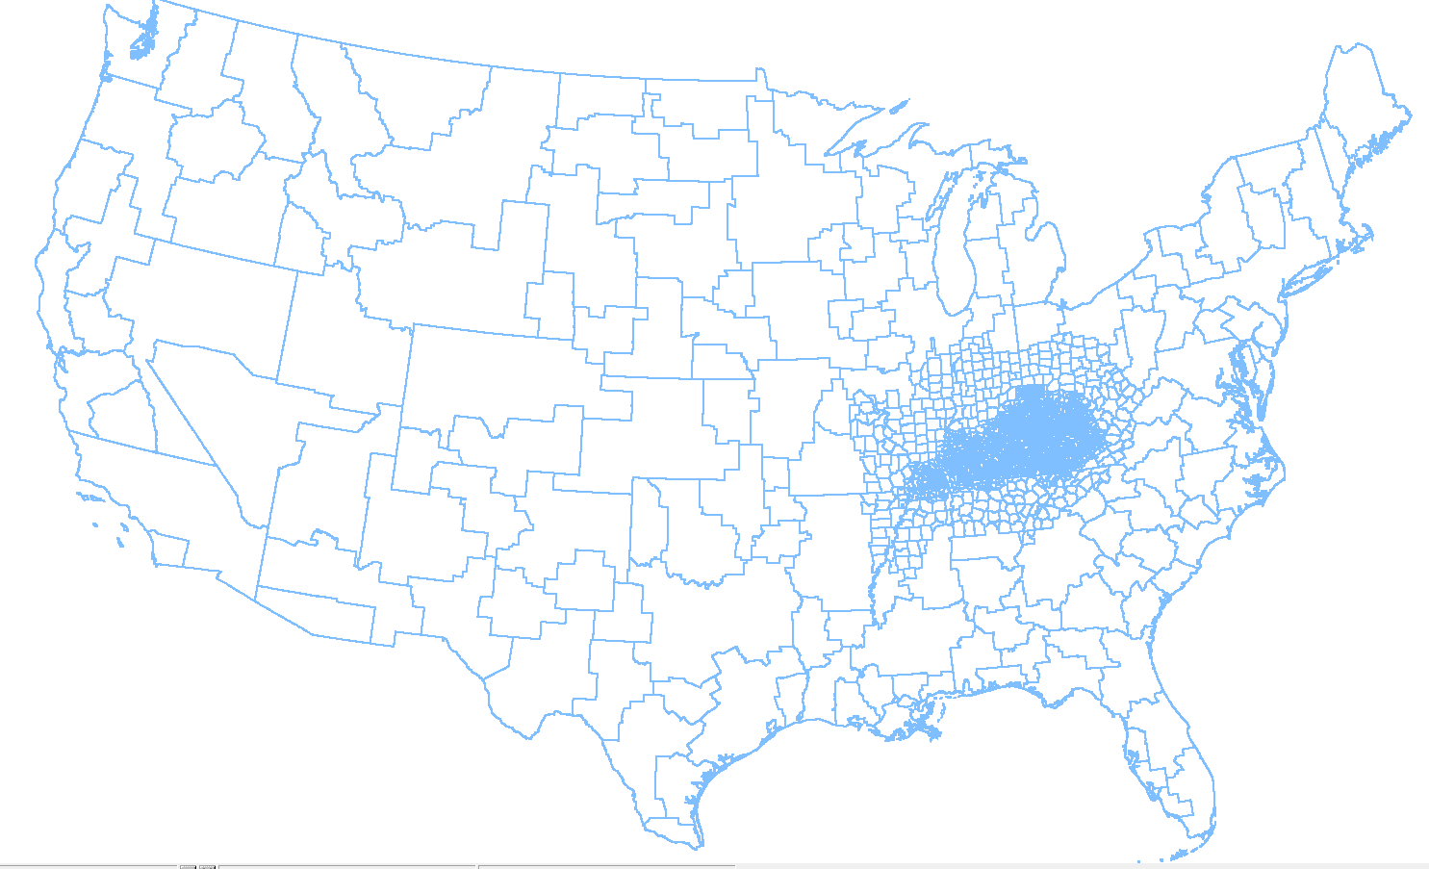
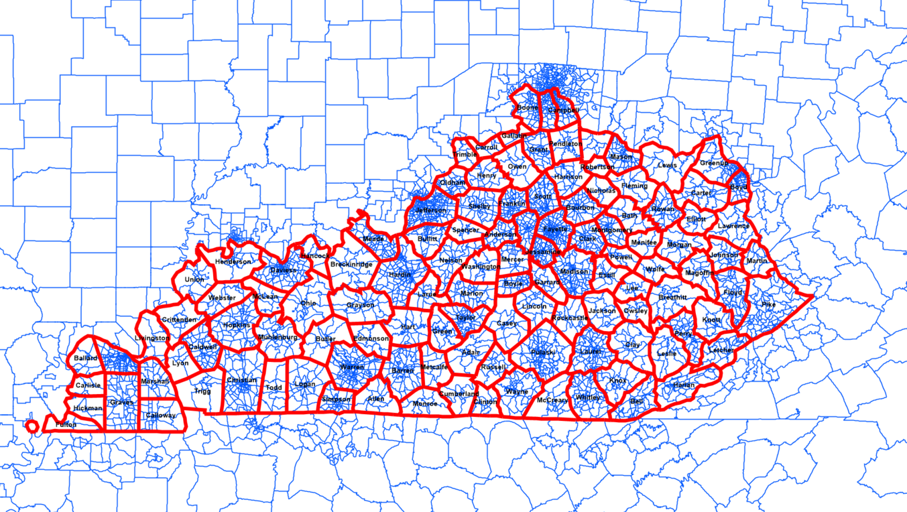
Traffic Analysis Zones
Covers U.S. mainland (5,843 zones)
Meso zones in neighboring states
Detailed zones in Kentucky (4,624 zones)

Slide 4
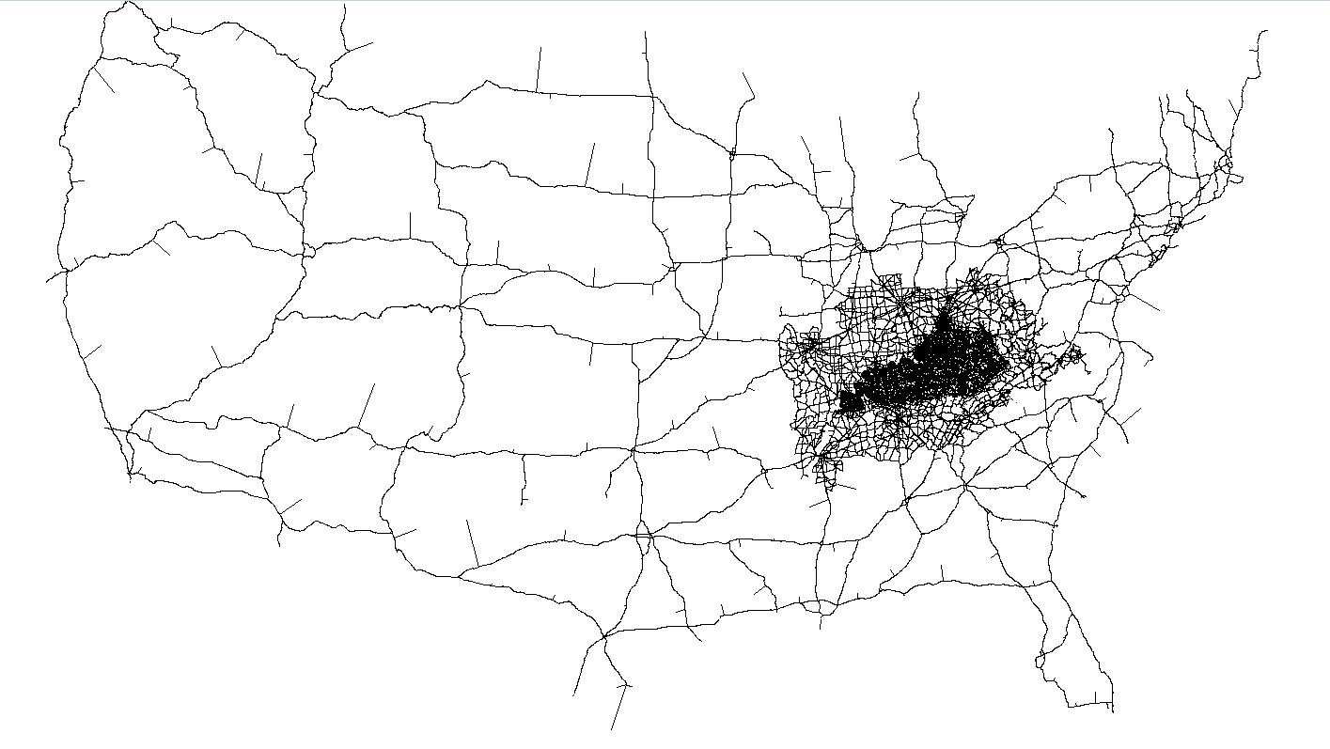
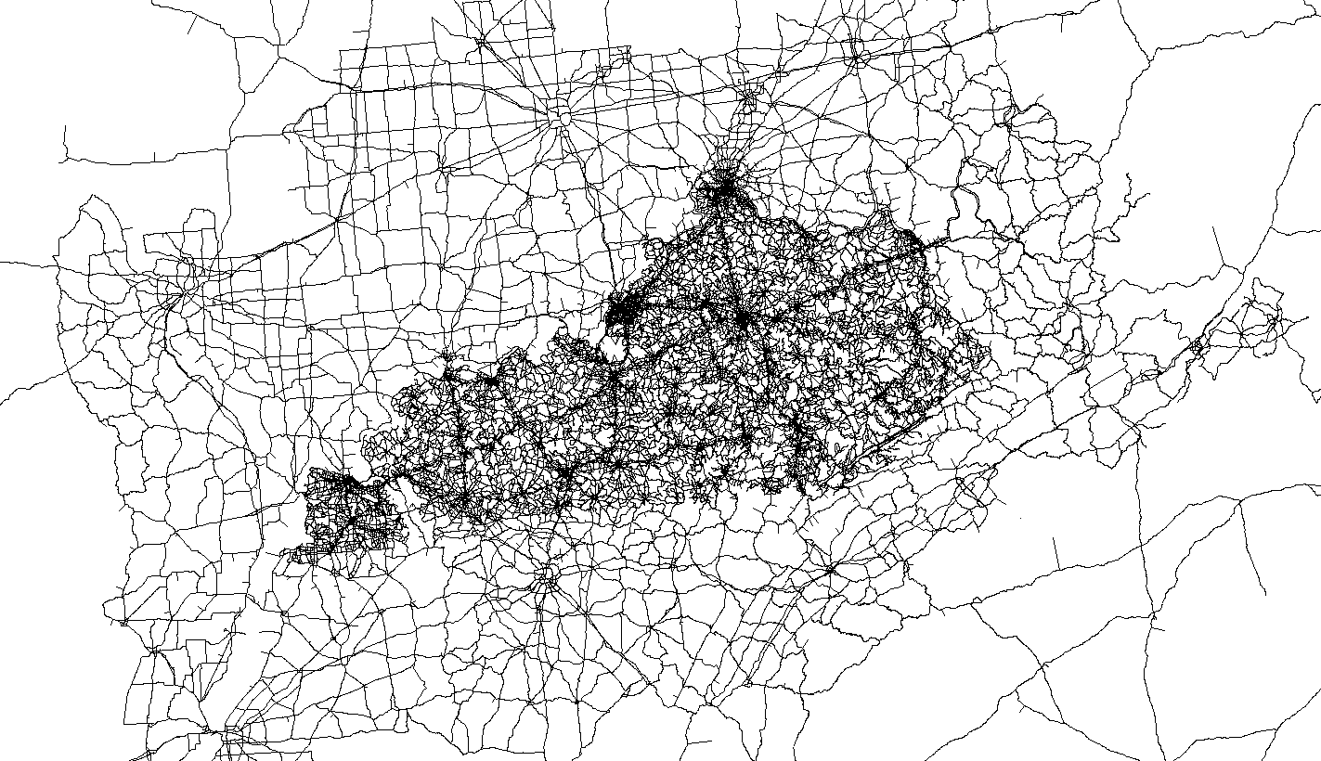
Network
Cover U.S. mainland (more than 86,000 links)
Relatively detailed network in neighbor states
Detailed network in Kentucky (more than 71,000 links)

Slide 5
Model Structure
A 3-step daily model (TransCAD 6)
Model procedure
  Speed/capacity calculator (HCM 2010)
  Trip purpose
      Auto – HBW, HBO, NHB, business, tourist, other long-distance trips
      Truck – single unit truck, combination truck
  Trip generation
  Trip distribution
      Growth factor models for HBW & trucks
      GM for all other trip purposes
  Trip assignment (preload trucks; MMA for autos)
  Highway evaluation

Slide 6
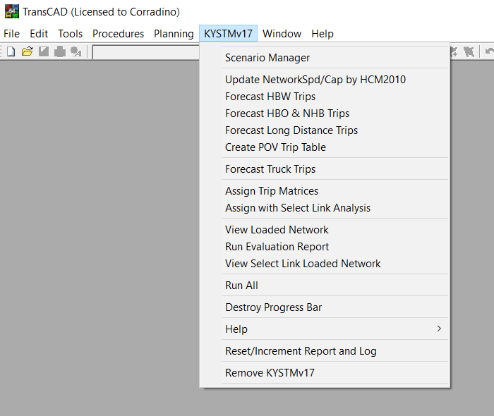
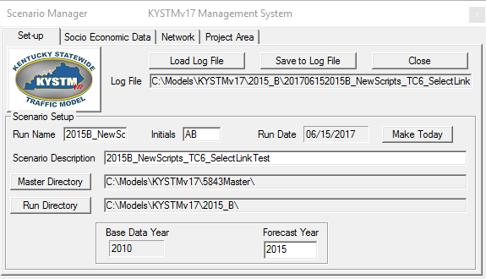
KYSTMv17 User Interface
TREDIS post-processor

Slide 7
Assignment Updates
Use MMA for auto assignment by trip purpose for TREDIS (instead of assigning a single total auto table). Purpose-specific flows are posted to the links.
Use tighter convergence (from 0.005 to 0.001) for MMA (and Gravity Model)
  More accurate traffic loads, particularly for parallel routes
  Manageable run time (20-30 mins)
Add congested travel time, VMT, VHT to loaded network by vehicle type (auto, SU trucks, Comb trucks for TREDIS)

Slide 8
TREDIS Post-Processor
Developed for Kentucky Transportation Cabinet (KYTC) to prepare the required inputs for TREDIS (Transportation Economic Development Impact System)
  Automatic process
  Minimal manual effort
The post-processor uses KYSTM output files. Therefore, the user must run the model for the desired scenario first.

Slide 9
TREDIS
Transportation Economic Development Impact System modeling software
  Economic impact analysis,
  Benefit-cost analysis,
  Financial analysis,
  Freight and trade impact analysis
TREDIS was chosen by KYTSC because it is the only system applicable for all modes – covering passenger and freight transport via aviation, marine and rail modes, as well as truck, car, bus, bicycle, and pedestrian travel
TREDIS can be used to make an assessment of the transportation and economic benefits of the different projects and supports the project selection process

Slide 10
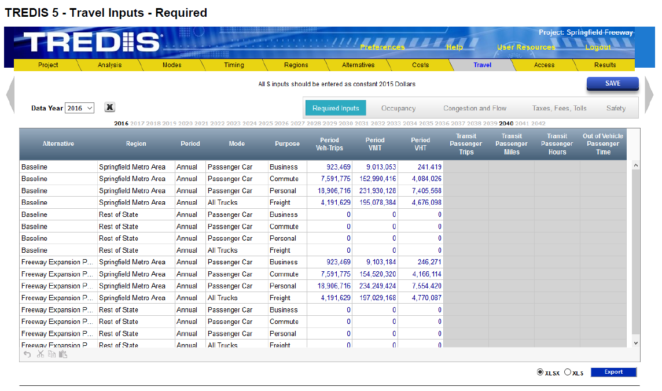
TREDIS Inputs created by the KYSTM

Slide 11
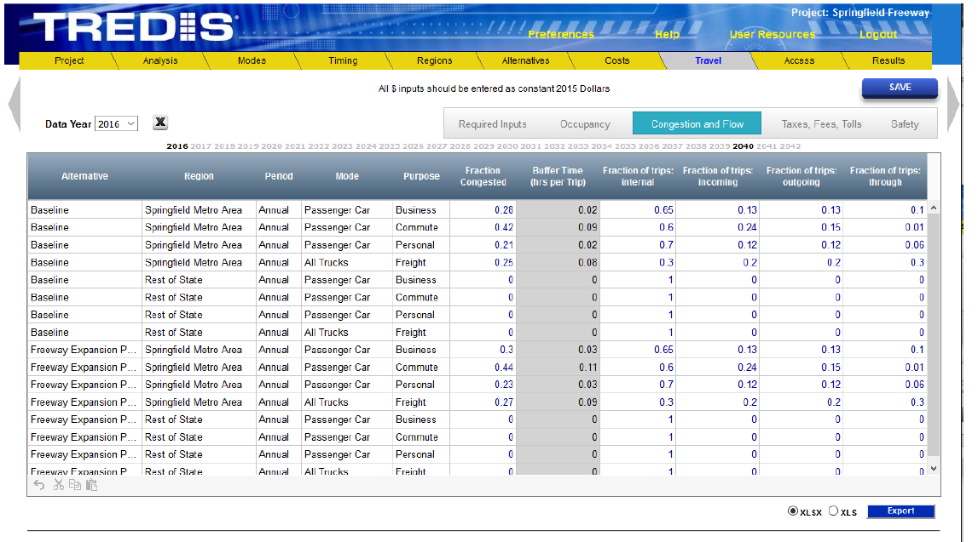
TREDIS Inputs created by the KYSTM (cont’d)

Slide 12
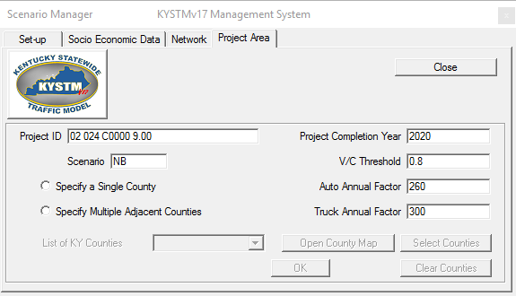
Post Processor User Interface
Default values for the parameters as shown in the figure are suggested by KYTC
Unique ID of the project to be analyzed
Fraction of congested miles based on this V/C threshold will be reported in the output file
Scenario Name (Build, NB, …)
Two options to analyze either single or multiple counties
Annual factors to convert daily trips

Slide 13
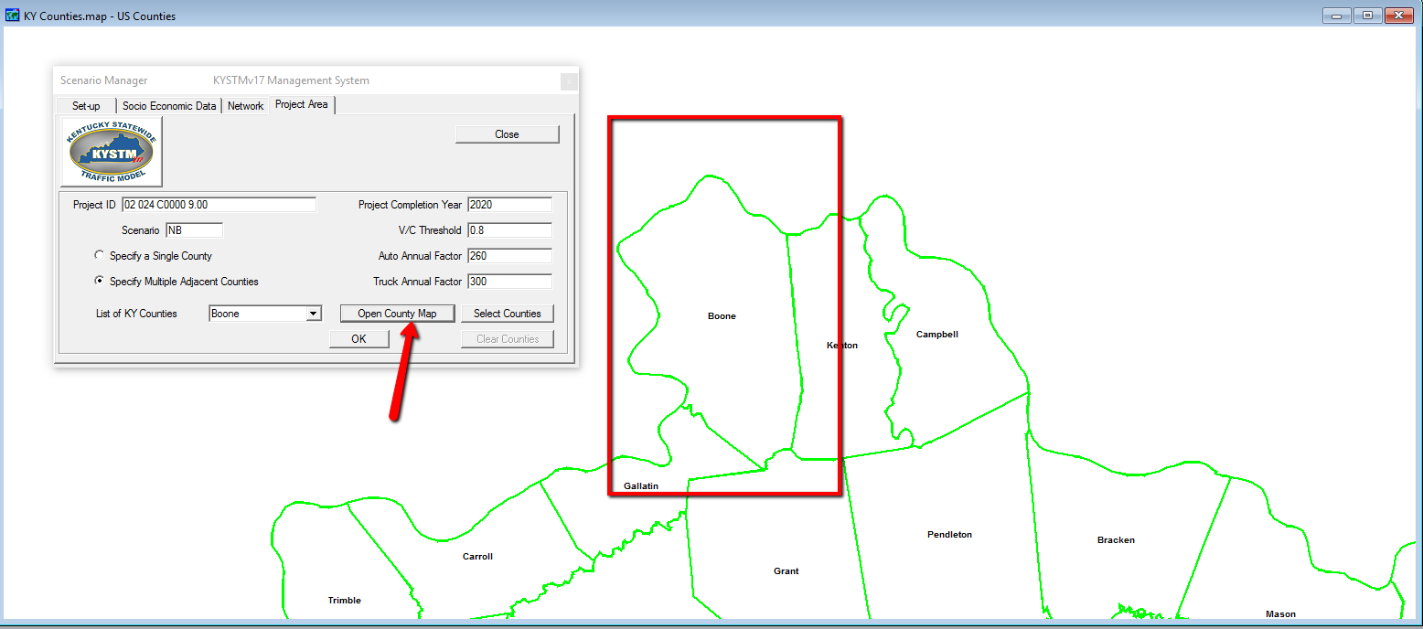
TREDIS User Interface – Selecting Multiple Counties

Slide 14
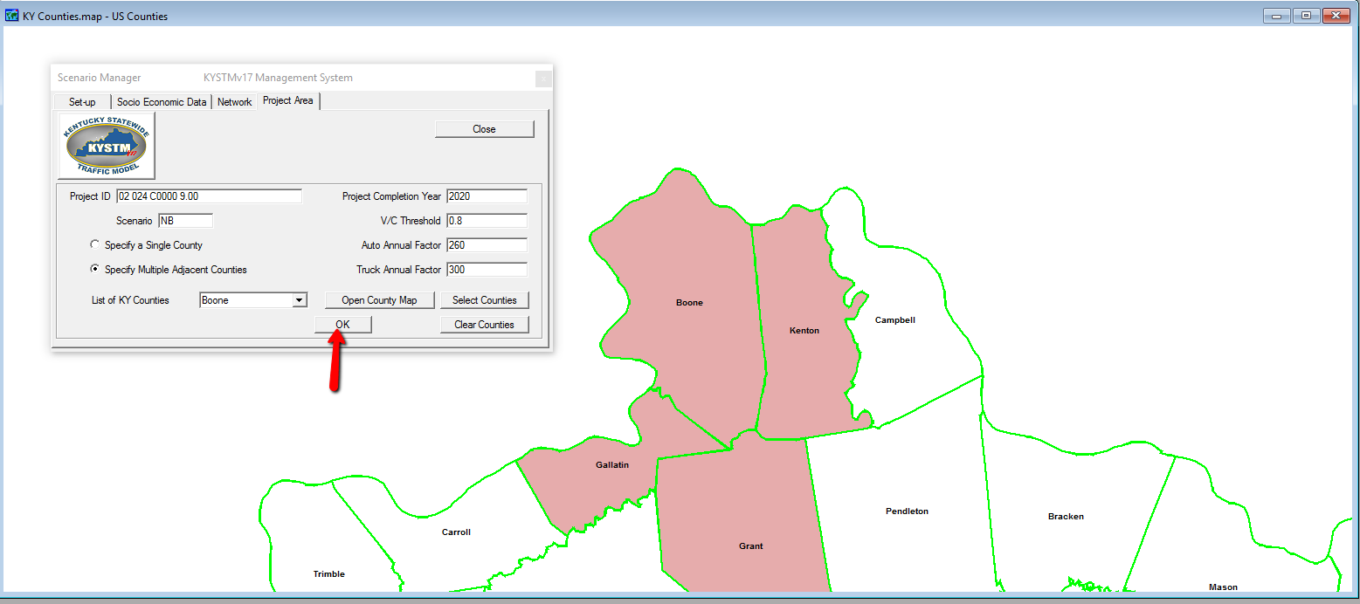
TREDIS User Interface – Running the Post-Processor

Slide 15
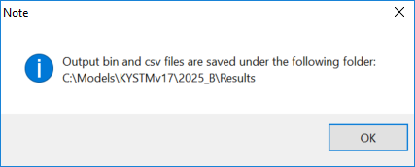
Post-Processor Run Completion

Slide 16
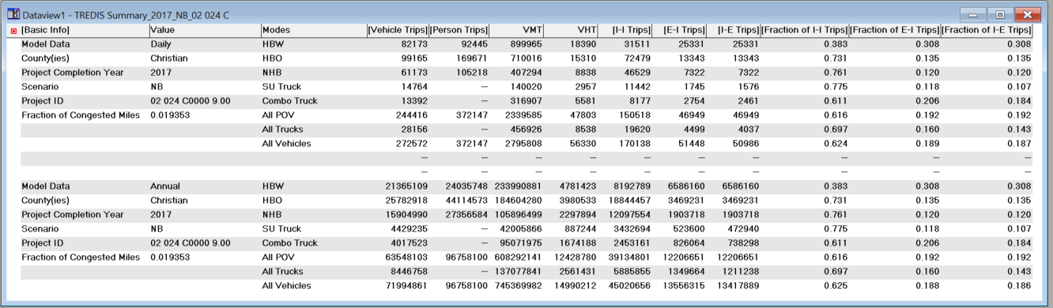
Output Files
Output files are saved in .bin and .csv format
  The values from the output files can be directly used as inputs to TREDIS
# of Trips
VMT/VHT
Purpose
II/EI/IE Trips
II/EI/IE Fractions

Slide 17
Output Files (cont’d)
Basic Info & Value: These two fields include the basic information about the scenario model run including the fraction of congested miles which is calculated based on the V/C Threshold parameter.
Modes: A list of all modes (The new KYSTMv17 processes 6 different auto trip purposes as well as two truck trip purposes):
    Auto – HBW, HBO, NHB, business, tourist, OtherLD
    Truck – SU truck, Comb truck
Vehicle Trips: Total number of vehicle trips by vehicle types & trip purpose
Person Trips: Total Number of person trips by vehicle types & trip purpose
VMT: Total vehicle miles traveled by each vehicle type & trip purpose
VHT: Total vehicle miles traveled by each vehicle type & trip purpose

Slide 18
Output Files (cont’d)
I-I Trips: Total internal-internal vehicle trips made by each vehicle type and trip purpose
E-I Trips: Total external-internal vehicle trips by each vehicle type and trip purpose
I-E Trips: Total internal-external vehicle trips by each vehicle type and trip purpose
Fraction of I-I Trips: Fraction of total internal-internal vehicle trips by each vehicle type and trip purpose
Fraction of E-I Trips: Fraction of total external-internal vehicle trips by each vehicle type and trip purpose
Fraction of I-E Trips: Fraction of total internal-external vehicle trips by each vehicle type and trip purpose

Slide 19
New Updates in Progress
Improve truck assignment & truck speed models
  The truck pre-load method most likely will be continued.
  A daily truck speed model, which will be a function of daily vehicle speeds and network attributes like terrain, will be added.
Improve zone splitting and traffic at KY state border
  Automate splitting of Fratar seed matrices (truck, HBW)
  For short EI/IE trips near the border, allow growth for cells with “0” seed table volume. In v17 there is no way to show growth.
Streamline sub-area extraction for use in regional models
  Extraction method is present but not easy to use.
  Will be simplified for the user.
Cleanup script
  Bi-conjugate Frank Wolfe (BFW in TC6) assignment implemented and tested.
  Network database no longer require the link layer to be called “Lines”.
  Many other fixes are being implemented.
Convert the scenario manager to the “standard” Caliper interface used in regional models

Slide 20
Questions ?

